Slide 1
Does Code Decay?
王瀚磊 陳立誠 李旭恩 綦家志 王本奕 高睦修

Slide 2
Yes. It will decay
if you don’t do anything.

Slide 3
Introduction - Problems
What is decay?
How to measure it?
How to deal with it?

Slide 4
Change
↓
Decay
Inevitable
Measurable
Repairable

Slide 5
Introduction - Change
A change is any alteration to the software recorded in the change history data base.
Why changes?
Feature addition
System change( hardware, environment, etc. )
What kind is the change?
Adaptive
Corrective
Perfective

Slide 6
How to explain
“Changes induce decay”?

Slide 7
“A unit of code is decayed
if it is harder to change than
it should be.”

Slide 8
Introduction - Decay
It exists.
Have to be measured.
CDIs (code decay indices)
CDIs:
the span of changes
breakdown of modularity
fault potentiol
prediction of effort

Slide 9
Quantify symptoms
Quantify risk factors
Predict response
—But at first, let’s build a system for change

Slide 10
IMR
MR
Delta
Add
Delete

Slide 11
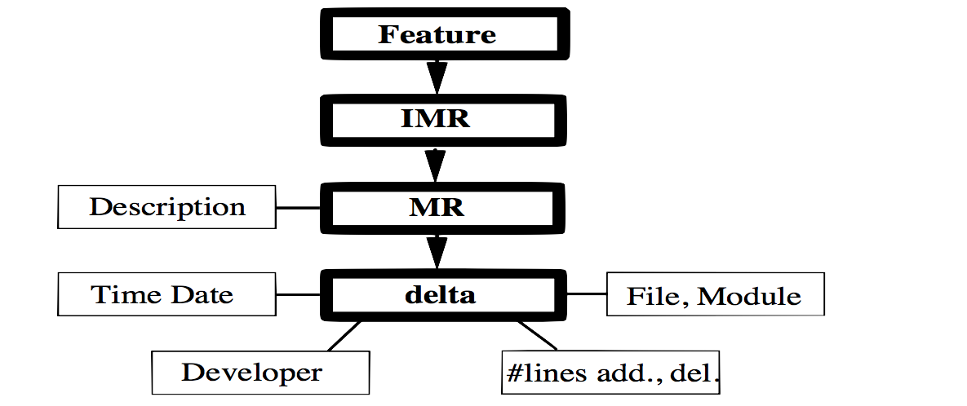
Process
What (file, code)
How many (file, module, lines)
Who
Why
When
How long
How much cost

Slide 12
What is Code Decay?
Code is decayed if it is difficult to change than it should be
3 key responses
COST of the change (key question!!)
INTERVAL of the change (must be met)
QUALITY of the change (must be attained)

Slide 13
What is Code Decay?
Code decay is a temporal phenomenon
Not all difficulty results from decay
Code can be correct and still be decayed
Decaying software may nevertheless be increasing in value
“No decay without change” operates only at high level
“Harder to change than it should be” is elusive

Slide 14
Cause of Code Decay
Inappropriate architecture
Violation of the original design principles
Imprecise requirement
Time pressure
Inadequate programming tools
Organizational environment
Programmer variability
Inadequate change process

Slide 15
Symptoms of Code Decay
Excessively complex(bloated)
A history of frequent changes
A history of faults
Widely dispersed changes
Kludge
Numerous interfaces

Slide 16
Risk Factor of Code Decay
Size
NCSL = Non-Commentary Source Lines
Age
Inherent complexity
Organizational churn
reorganization
Ported or reused code
Requirements load
Inexperiencened developes

Slide 17
3.3 Symptoms of Code Decay
Excessively complex (bloated) code
History of frequent changes
History of faults
Widely dispersed changes
Kludges
Numerous interfaces
Notes:
程式過度的複雜，比原本需要的樣子還複雜。有兩種特性：巢狀複雜化以及第六點提到的多種interface
過度平凡的修改code
過多的錯誤，不單單只是造成修改程式的頻繁，也間接表示這些修改不會使得程式變得更好，有可能只是頭痛醫頭腳痛醫腳的概念
Modularized是local的，如果是修改的地方廣泛的散步，意味著同樣的功能可能動到不一樣的module，
Kludge表示庫拉機（拼裝車），有些開發者偷懶沒有按照正常的process開發程式，利用偷吃步的方法以為可以快速寫完，但這樣所造成的風險更大（舉例：為了方便忽略封裝）
太多的介面表示要修改一個部分的時候需要注意的地方會必得很多

Slide 18
3.4 Risk Factors for Code Decay
The size of a module
The age of a code
Inherent complexity
Organization churn
Ported or reused code
Requirement load
Inexperienced developers
Notes:
風險因素，如在醫學上，增加了代碼衰減的可能性或加劇了它的作用。 它們本身不一定是指標或衰變的原因，但即使沒有症狀也引起關注。
大的module更容易存在3.3所提到的每個病因
老的程式碼有可能被忽略，或是因為需要修改的機會比較多
程式的複雜性，導致要修改的時候會發現比原本預期的難修改
組織流失（即營業額或重組）通過降低知識基礎來增加衰退的風險，也可能增加缺乏經驗的開發人員改變代碼的可能性
移植或重新使用的code使用不同的語言撰寫，針對不同的系統或另一個平台
要求負載很重時，意味著代碼具有廣泛的功能，並受到許多限制，難以實現
沒有經驗的開發人員對早期的系統缺乏經驗，潛在的技能較低

Slide 19
Code Decay Indices
DELTAS(c):number of deltas associated with c
ADD(c):number of lines added by c
DEL(c):number of lines deleted by c
DATE(c):the date on which c is completed;which we term the date of c
INT(c):interval of c; the (calendar) time required to implement c
DEV(c):number of developers implementing c

Slide 20
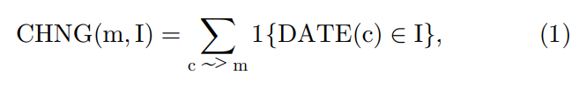
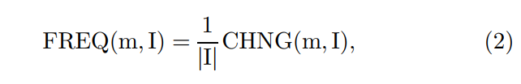
Code Decay Indices
History of Frequent Changes
Count fo changes
Frequency of changes

Slide 21
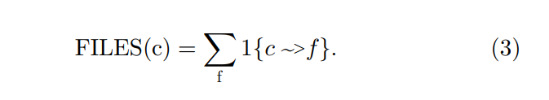
Code Decay Indices
Span of Changes
The files it touches
Difficult to get expertize to unfamiliar files
Breakdown of encapsulation and modularity
More files, larger change

Slide 22
Code Decay Indices
Size
The number of non-commentary source lines, NCSL(m)
Complexity in dataset almost perfectly correlated with NCSL
Age
Average age of its constituent lines

Slide 23
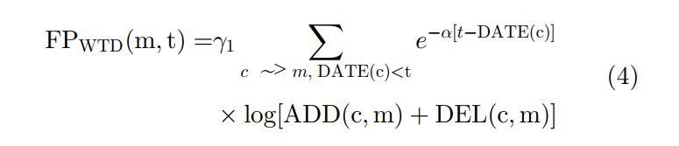

Code Decay Indices
Fault Potential
Faults that will have to be fixed in module m in future interval of time

Slide 24
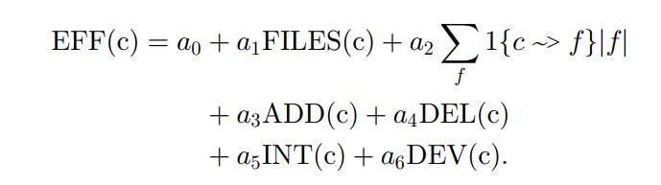
Code Decay Indices
Effort
Effort required to implement change by regression equations

Slide 25
THE EVIDENCE FOR DECAY
Temporal Behavior of the Span of Changes
Time Behavior of Modularity
Prediction of Faults
Models for Effort

Slide 26
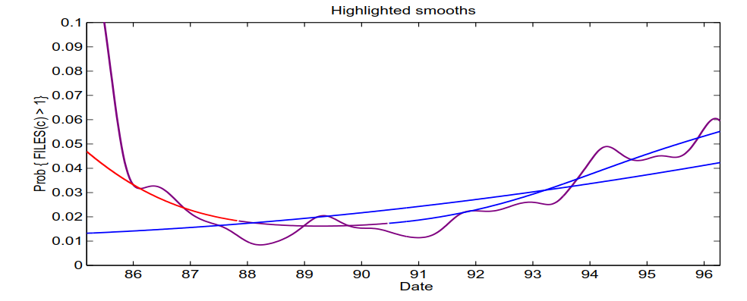
Temporal Behavior of the Span of Changes
The overall trend has been a significant increase in the difficulty of changes

Slide 27
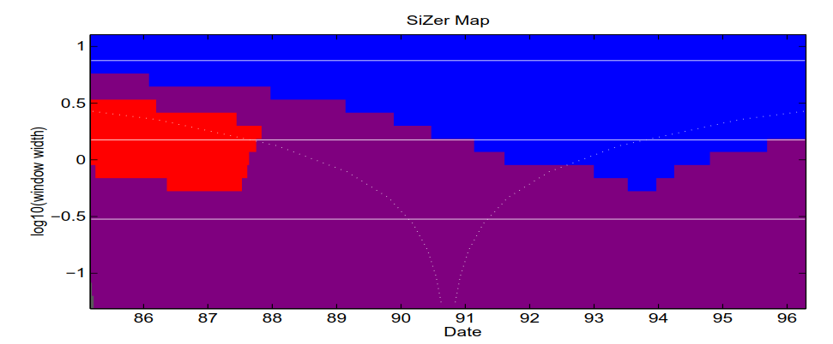
Temporal Behavior of the Span of Changes

Slide 28


Time Behavior of Modularity
m , m’ = module
I = interval of time

Slide 29
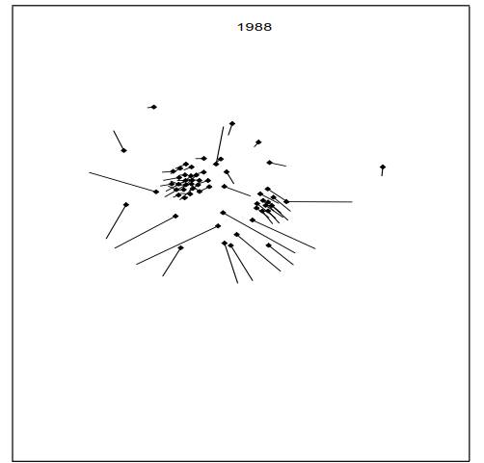
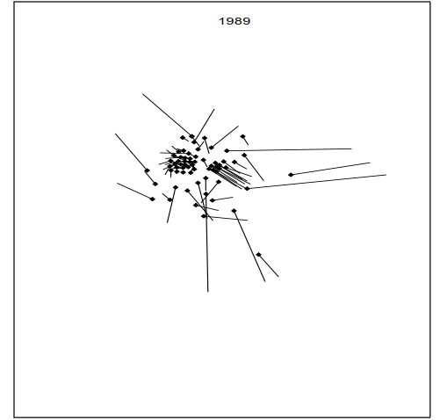
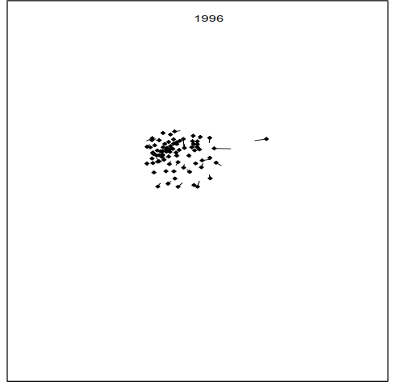


Slide 30
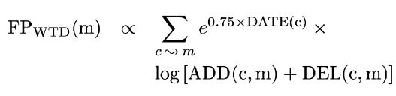
Prediction of Faults
large, recent changes add the most to fault potential

